Slide 1
INTRODUCTION
OBJECTIVE
CLASSIFICATION
REQUIREMENTS
FEATURES
ADVANTAGES
DATA MINING TECHNIQUES REVIEW 2
ITE2006
E1+TE1
Movie Success Prediction System using Data Mining

Slide 2
INTRODUCTION
OBJECTIVE
CLASSIFICATION
REQUIREMENTS
FEATURES
ADVANTAGES
TEAM MEMBER
NAME | REG NO
JEBARAJ.M | 15BIT0354
Faculty : Prof .Thippa Reddy

Slide 3
Overview
INTRODUCTION
OBJECTIVE
CLASSIFICATION
REQUIREMENTS
FEATURES
ADVANTAGES
Introduction
Objective
Abstract
Classification
Requirements
Features
Advantages
Screenshots

Slide 4
Introduction
INTRODUCTION
OBJECTIVE
CLASSIFICATION
REQUIREMENTS
FEATURES
ADVANTAGES
The Indian movie industry produces the maximum number of movies per
year at 1000/year, higher than any other country’s movie industry.
The IMDb is an excellent resource to find detailed information about
almost any film ever made. It contains a vast amount of data, which
undoubtedly contains much valuable information about general trends in
films.
Data mining techniques allows us to predict the success of a future film
given select information about the film before its release. So we will get the
data from IMDb and predict the movie success by applying the
mathematical concept.

Slide 5
Objective
INTRODUCTION
OBJECTIVE
CLASSIFICATION
REQUIREMENTS
FEATURES
ADVANTAGES
India, is a movie fanatic nation, but there is no composite movie
database or a credible source for movie-ratings
This system answers the follwing question
1. Do Super-stars matter ?
2. Do Star director’s matter ?
3. Does Budget of a movie matter?
4. Do famous Writers, Producers matter?
By predicting the movie success user can easily decide whether
to book the ticket in advance or not. It will save the user time.

Slide 6
Abstract
INTRODUCTION
ABSTRACT
CLASSIFICATION
REQUIREMENTS
FEATURES
ADVANTAGES
In this system I am going to develop a mathematical model for predicting the success class such as flop, hit, super hit of the movies.
For doing this I have to develop a methodology in which the historical data of each component such as actor, actress, director, music that influences the success or failure of a movie is given is due to weightage and then based on multiple thresholds calculated on the basis of descriptive statistics of dataset of each component it is given class flop, hit, super hit label.
Admin will add the film crew data. Admin will add movies data of a particular film crew. Admin will add new movie data along with film crew details of the new movie.

Slide 7
Abstract
INTRODUCTION
ABSTRACT
CLASSIFICATION
REQUIREMENTS
FEATURES
ADVANTAGES
Based on the weightage of historical data of each film crew the movie will be labeled as super hit, hit or flop.
This system helps to find out whether the movie is super hit, hit, flop on the basis of historical data of actor, actress, music director, writer, director, marketing budget and release date of the new movie.
The factors such as actor, actress, director, writer, music director and marketing budget historical data of each component are calculated and movie success is predicted.
This application helps to find out the review of the new movie. Due to this system, user can easily decide whether to book ticket in advance or not.

Slide 8
Classfication
INTRODUCTION
OBJECTIVE
CLASSIFICATION
REQUIREMENTS
FEATURES
ADVANTAGES
Classification can be used to predict the future data trends.
The data analysis task is classification, where a model or
classifier is constructed to predict categorical labels.
For this system we classify the label such as flop,hit,super hit.

Slide 9
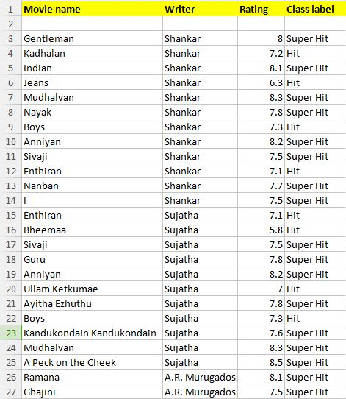
Writer
INTRODUCTION
OBJECTIVE
CLASSIFICATION
REQUIREMENTS
FEATURES
ADVANTAGES

Slide 10
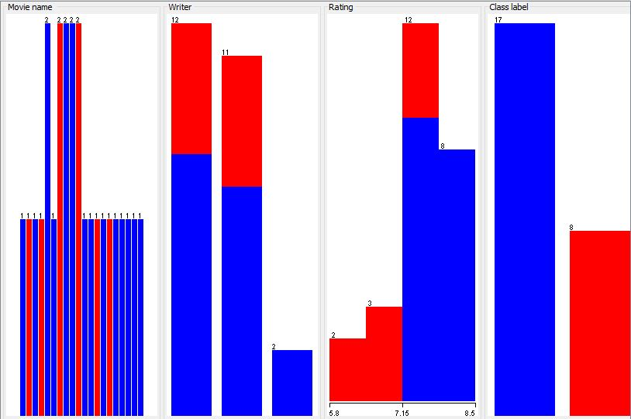
Writer-Preprocessing
INTRODUCTION
OBJECTIVE
CLASSIFICATION
REQUIREMENTS
FEATURES
ADVANTAGES

Slide 11
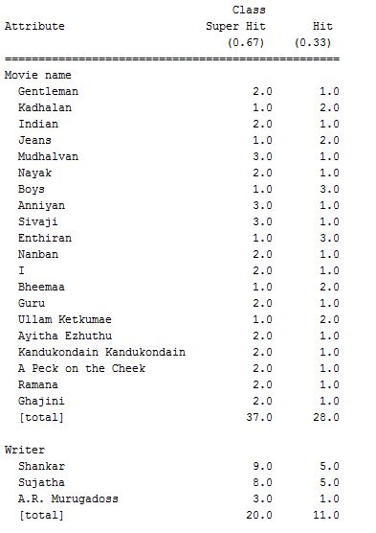
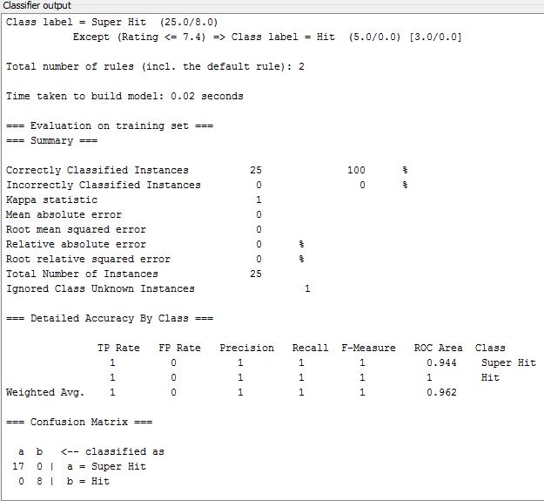
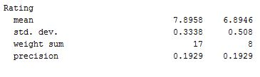
Writer-NaiveBayes
INTRODUCTION
OBJECTIVE
CLASSIFICATION
REQUIREMENTS
FEATURES
ADVANTAGES

Slide 12
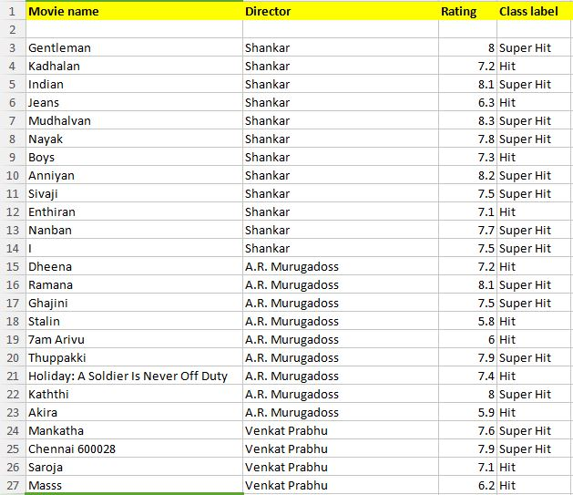
Director
INTRODUCTION
OBJECTIVE
CLASSIFICATION
REQUIREMENTS
FEATURES
ADVANTAGES

Slide 13
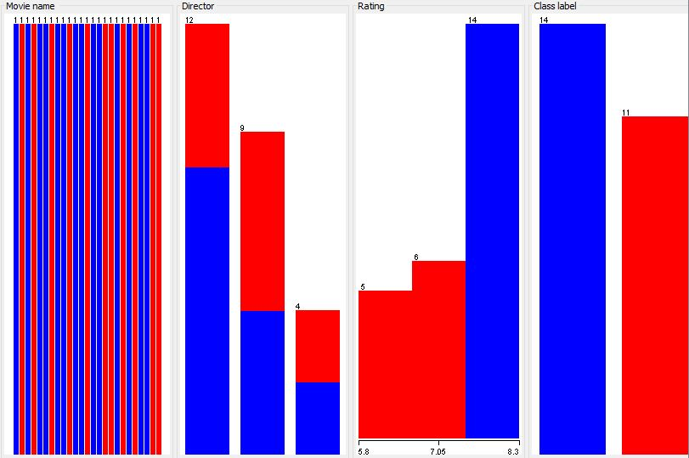
Director-Preprocessing
INTRODUCTION
OBJECTIVE
CLASSIFICATION
REQUIREMENTS
FEATURES
ADVANTAGES

Slide 14
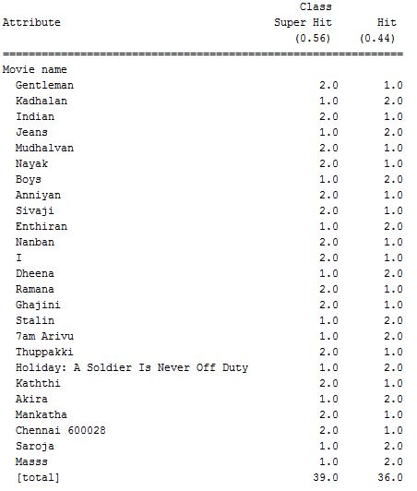
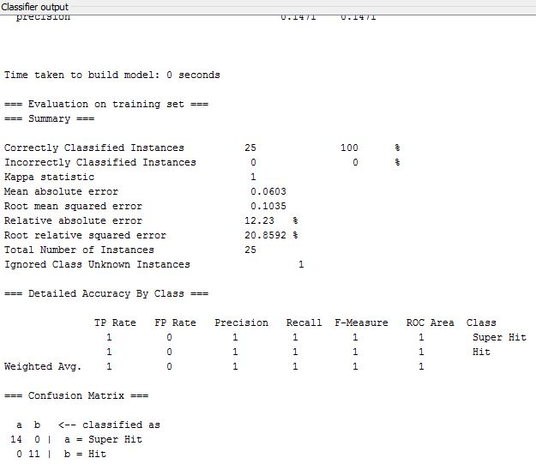
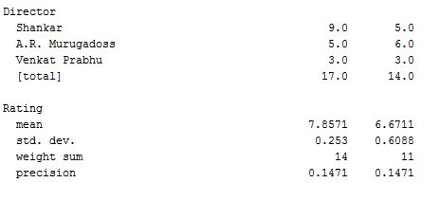
Director-NaiveBayes
INTRODUCTION
OBJECTIVE
CLASSIFICATION
REQUIREMENTS
FEATURES
ADVANTAGES

Slide 15
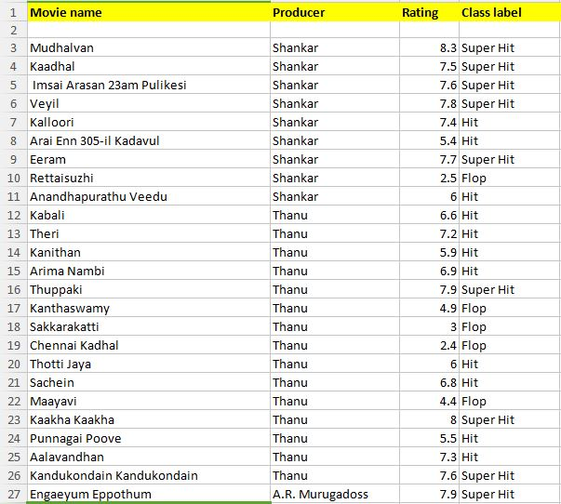
Producer
INTRODUCTION
OBJECTIVE
CLASSIFICATION
REQUIREMENTS
FEATURES
ADVANTAGES

Slide 16
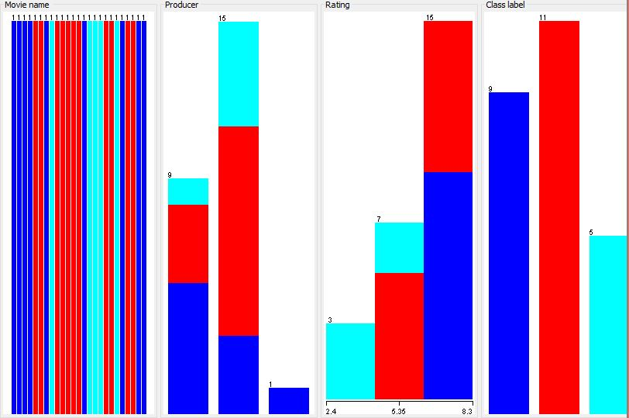
Producer-Preprocessing
INTRODUCTION
OBJECTIVE
CLASSIFICATION
REQUIREMENTS
FEATURES
ADVANTAGES

Slide 17
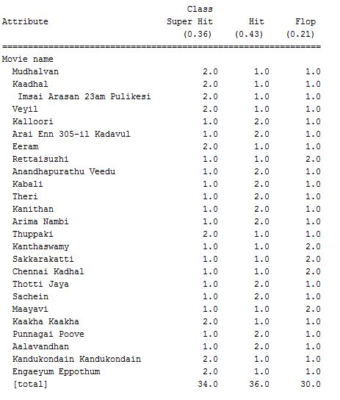
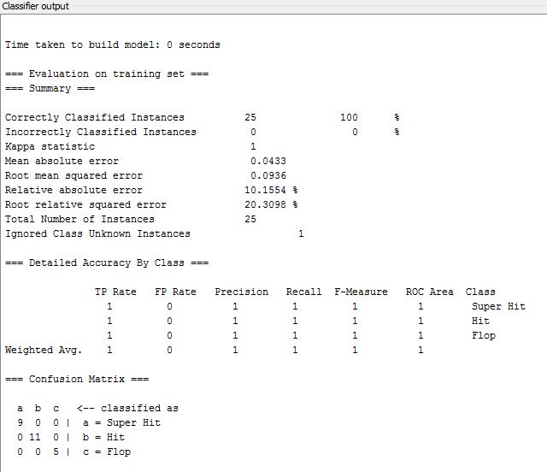
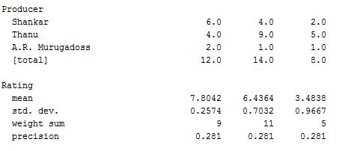
Producer-NaiveBayes
INTRODUCTION
OBJECTIVE
CLASSIFICATION
REQUIREMENTS
FEATURES
ADVANTAGES

Slide 18
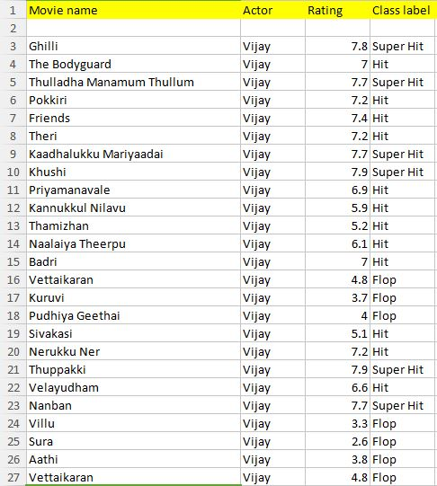
Actor
INTRODUCTION
OBJECTIVE
CLASSIFICATION
REQUIREMENTS
FEATURES
ADVANTAGES

Slide 19
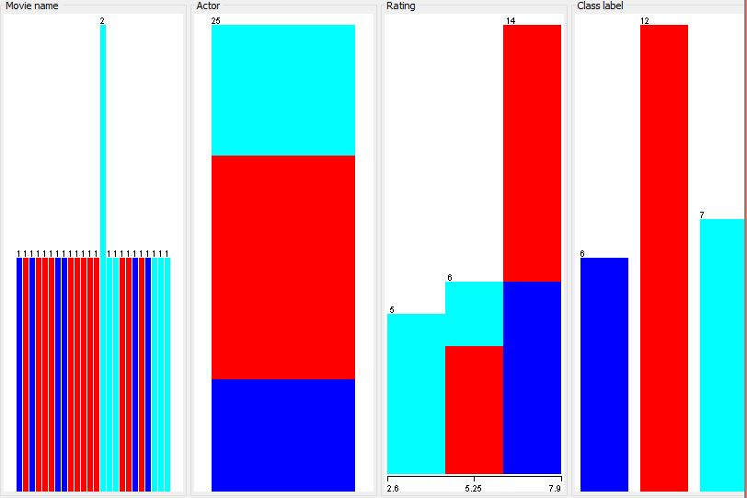
Actor-Preprocessing
INTRODUCTION
OBJECTIVE
CLASSIFICATION
REQUIREMENTS
FEATURES
ADVANTAGES

Slide 20
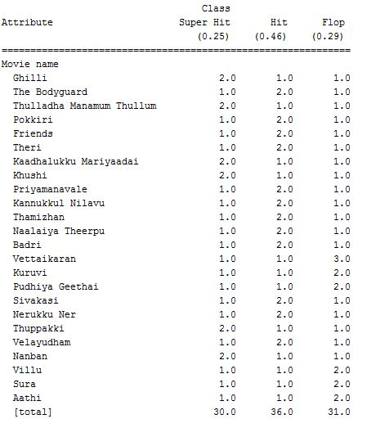
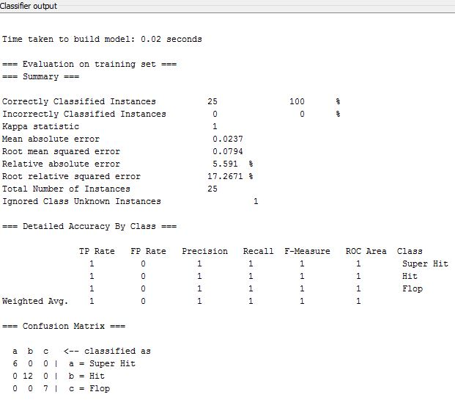
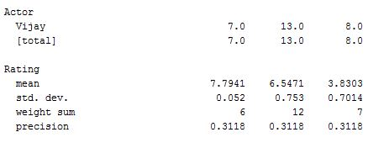
Actor-NaiveBayes
INTRODUCTION
OBJECTIVE
CLASSIFICATION
REQUIREMENTS
FEATURES
ADVANTAGES

Slide 21
Requirements
INTRODUCTION
OBJECTIVE
CLASSIFICATION
REQUIREMENTS
FEATURES
ADVANTAGES
Software Requirements:
* Windows
* Wampserver
* MySql
Hardware Requirements:
* Processor – Pentium IV
* 64 bit operating system
* Hard Disk – 70GB
* Memory – 2GB RAM

Slide 22
Features
INTRODUCTION
OBJECTIVE
CLASSIFICATION
REQUIREMENTS
FEATURES
ADVANTAGES
Admin Login:
Admin can access the system using his admin ID and password.
New Movie Entry:
Admin adds new movie data.
(Movie name,Director,Producer,Actor,Actress,Music director,Marketting
budget,etc..)
Film Crew Entry:
Admin adds film crew details and also enters historical data of each crew.
Result:
Admin can view whether a movie is super hit, hit or flop.

Slide 23
Advantages
INTRODUCTION
OBJECTIVE
CLASSIFICATION
REQUIREMENTS
FEATURES
ADVANTAGES
This application helps to find out the review of the new movie.
User can easily decide whether to book ticket in advance or not.
This application can be used by all the movie lovers.
Disadvantage:
User can predict the success of the movie before the release of movie.

Slide 24
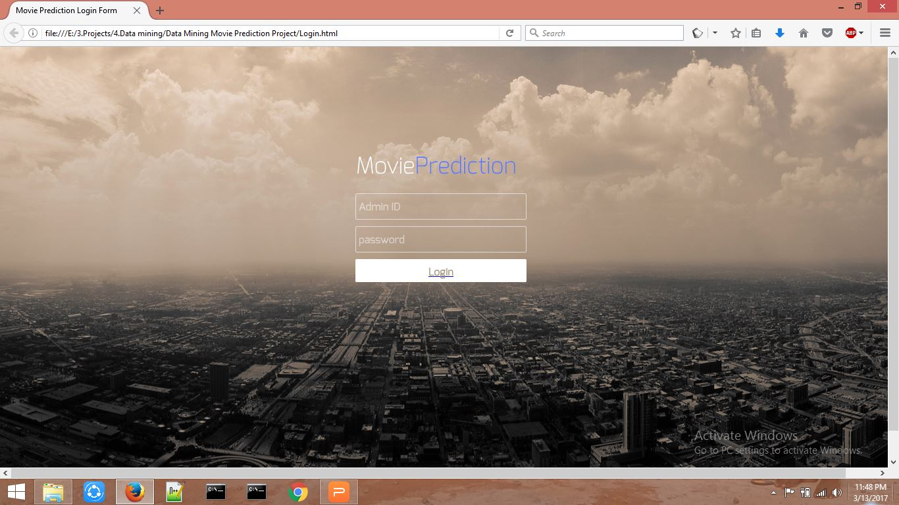
OBJECTIVE
CLASSIFICATION
REQUIREMENTS
FEATURES
ADVANTAGES
SCREENSHOTS

Slide 25
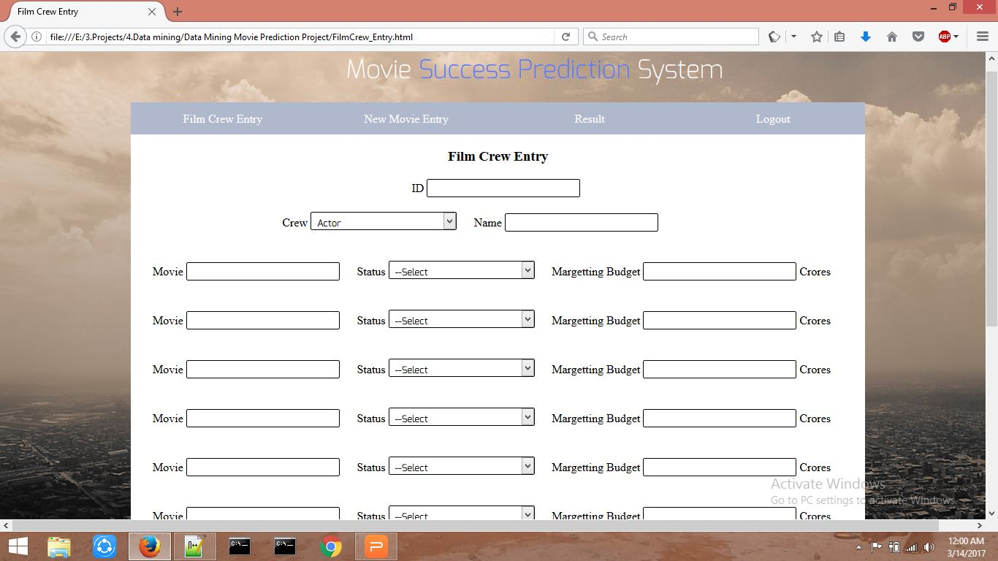
OBJECTIVE
CLASSIFICATION
REQUIREMENTS
FEATURES
ADVANTAGES
SCREENSHOTS

Slide 26
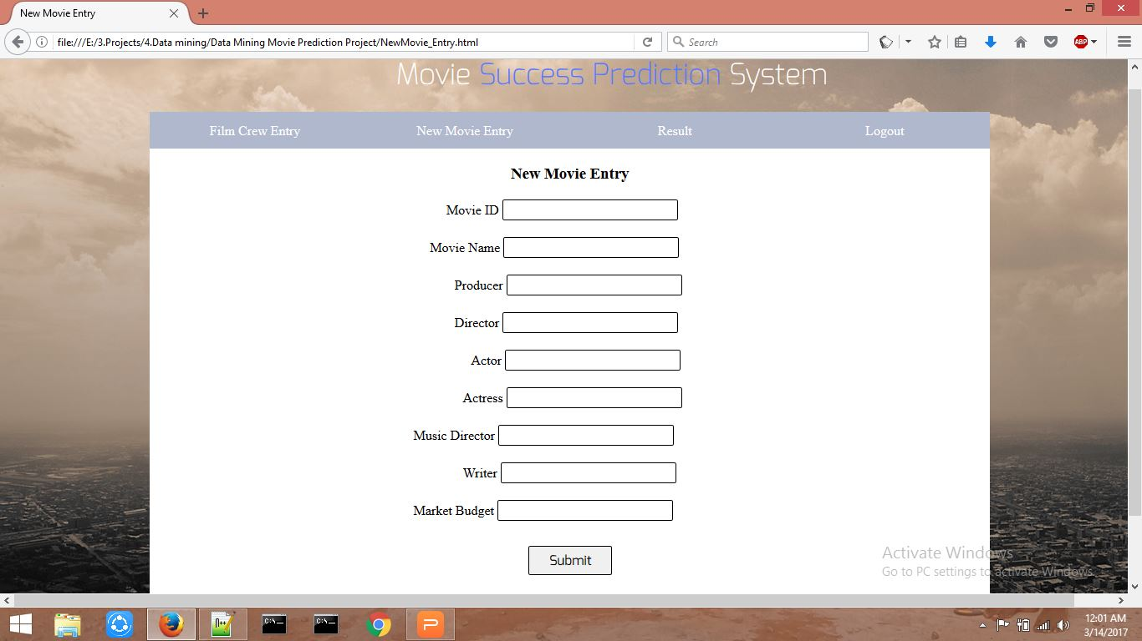
OBJECTIVE
CLASSIFICATION
REQUIREMENTS
FEATURES
ADVANTAGES
SCREENSHOTS

Slide 27
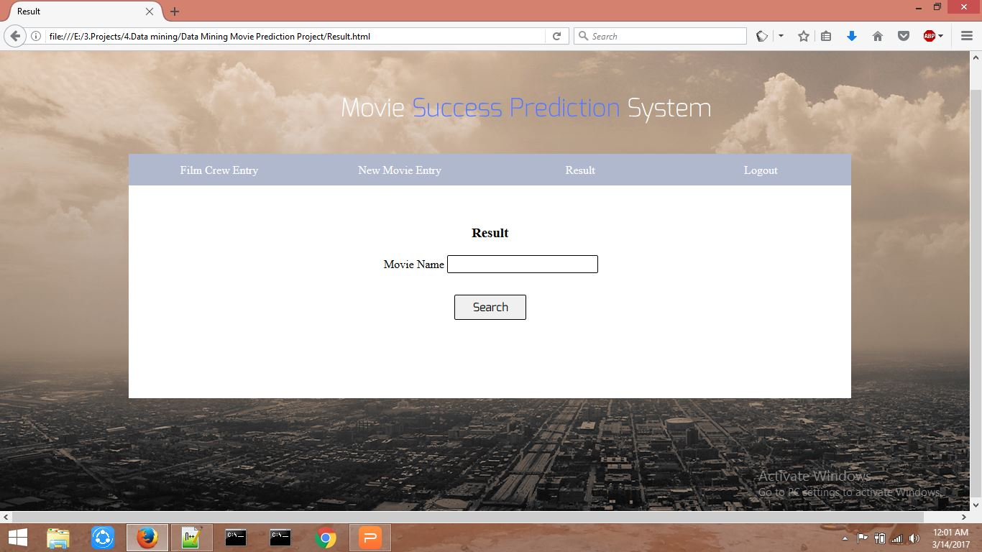
OBJECTIVE
CLASSIFICATION
REQUIREMENTS
FEATURES
ADVANTAGES
SCREENSHOTS

Slide 28
INTRODUCTION
OBJECTIVE
CLASSIFICATION
REQUIREMENTS
FEATURES
ADVANTAGES
THANK YOU

